Slide 1
Efficient Algorithms
Ekkapot Charoenwanit
Electrical and Computer Engineering (ECE)
TGGS
KMUTNB

Slide 2
Lecture 13: Approximation Algorithms

Slide 3
Solving Hard Problems
Currently, we do not know any polynomial-time algorithms for any NP-complete problems.
Therefore, solving them exactly is bound to be computationally expensive for sufficiently large problem sizes.
Yet, many of NP-complete are too important to abandon just because we do not know how to solve them optimally.

Slide 4
Solving Hard Problems
The following are strategies we can use to solve NP-complete problems:
Solve them optimally using an exponential-time algorithm
This works for problem sizes that are not too large
Solve special cases for which we know polynomial-time algorithms
Solve them sub-optimally in polynomial time with approximation algorithms
Approximate solutions are guaranteed to differ from optimal solutions within certain factors called approximation ratios

Slide 5
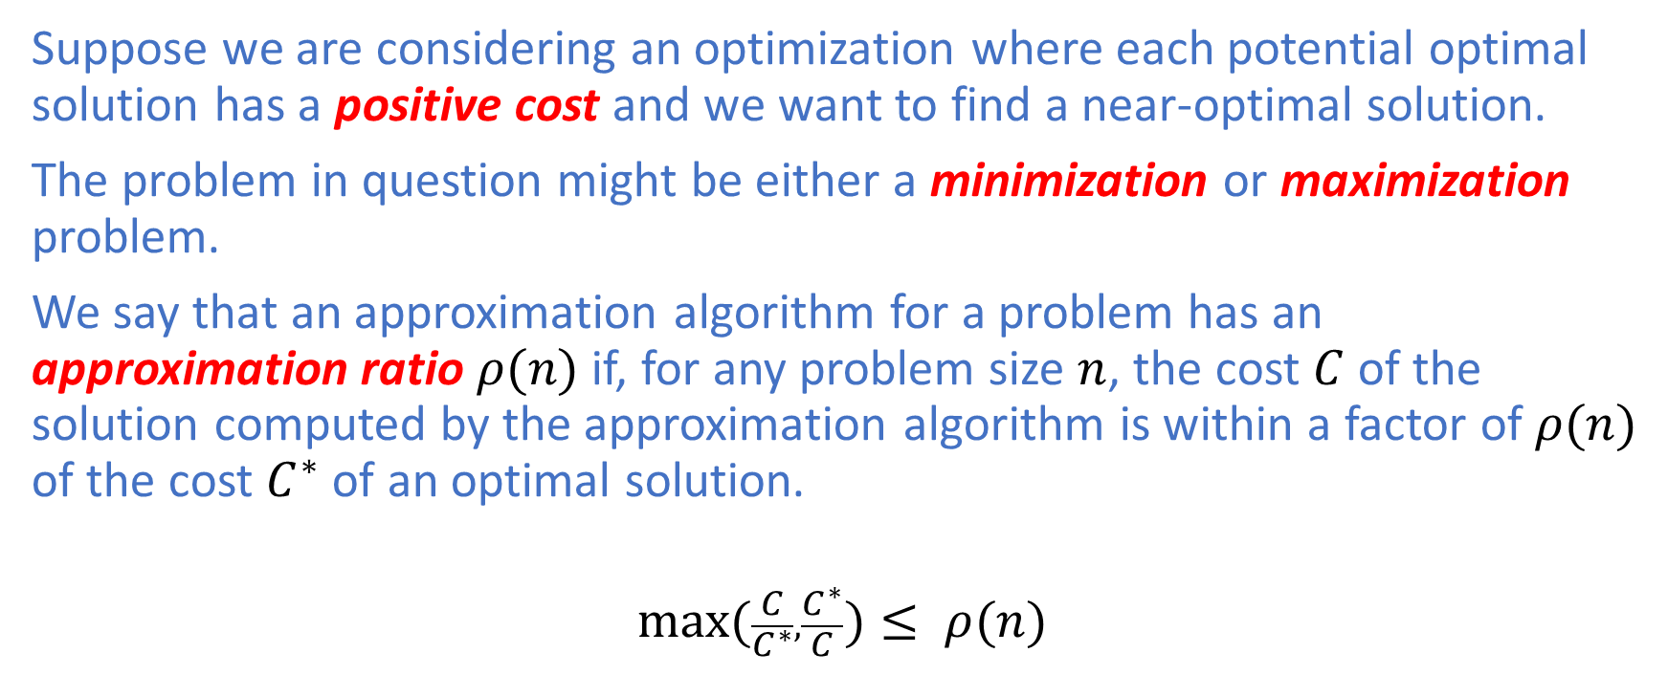
Approximation Ratios
Suppose we are considering an optimization where each potential optimal solution has a positive cost and we want to find a near-optimal solution.
The problem in question might be either a minimization or maximization problem.
We say that an approximation algorithm for a problem has an approximation ratio $ρ(n)$ if, for any problem size $n$, the cost $C$ of the solution computed by the approximation algorithm is within a factor of $ρ(n)$ of the cost $C^{∗}$ of an optimal solution.
$$\max_{}{(\frac{C}{C^{∗}},\frac{C^{∗}}{C}})≤ ρ(n)$$

Slide 6
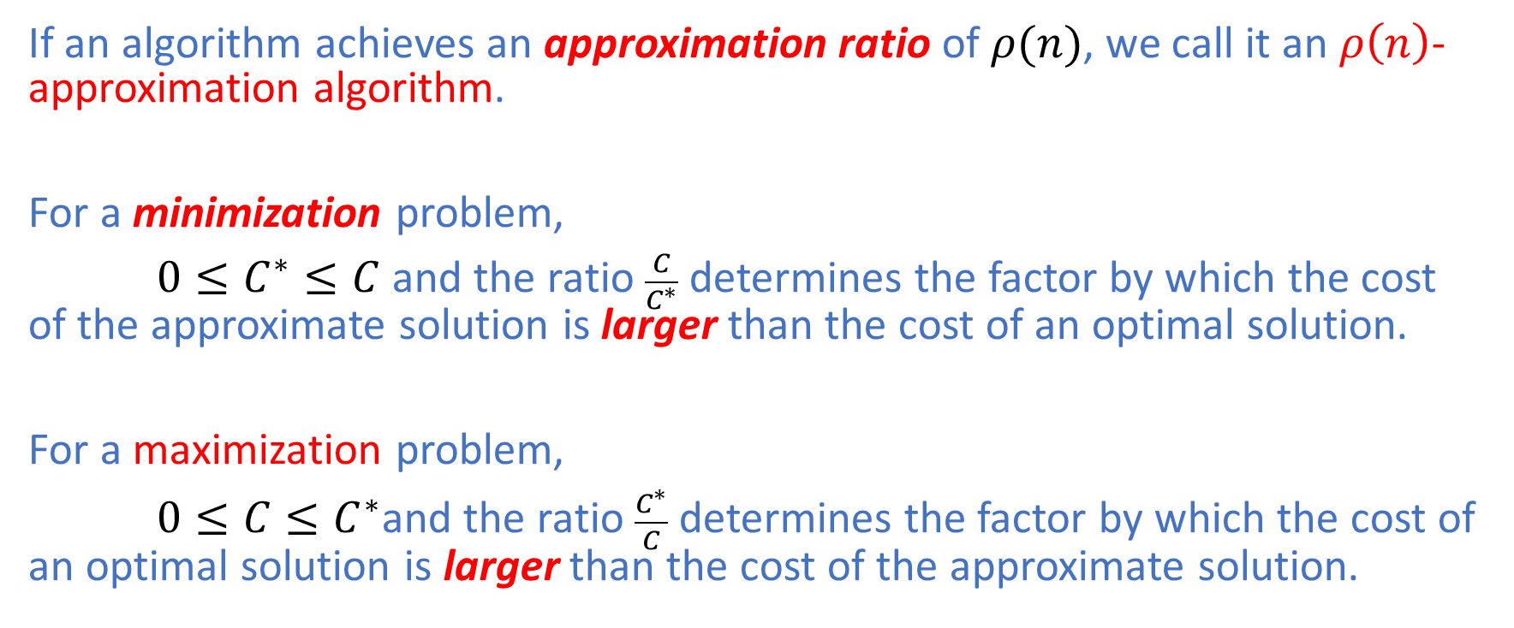
Approximation Ratios
If an algorithm achieves an approximation ratio of $ρ(n)$, we call it an $ρ\left(n\right)$-approximation algorithm.
For a minimization problem,
$0≤C^{∗}≤C$ and the ratio $\frac{C}{C^{∗}}$ determines the factor by which the cost of the approximate solution is larger than the cost of an optimal solution.
For a maximization problem,
$0≤C≤C^{∗}$and the ratio $\frac{C^{∗}}{C}$ determines the factor by which the cost of an optimal solution is larger than the cost of the approximate solution.

Slide 7
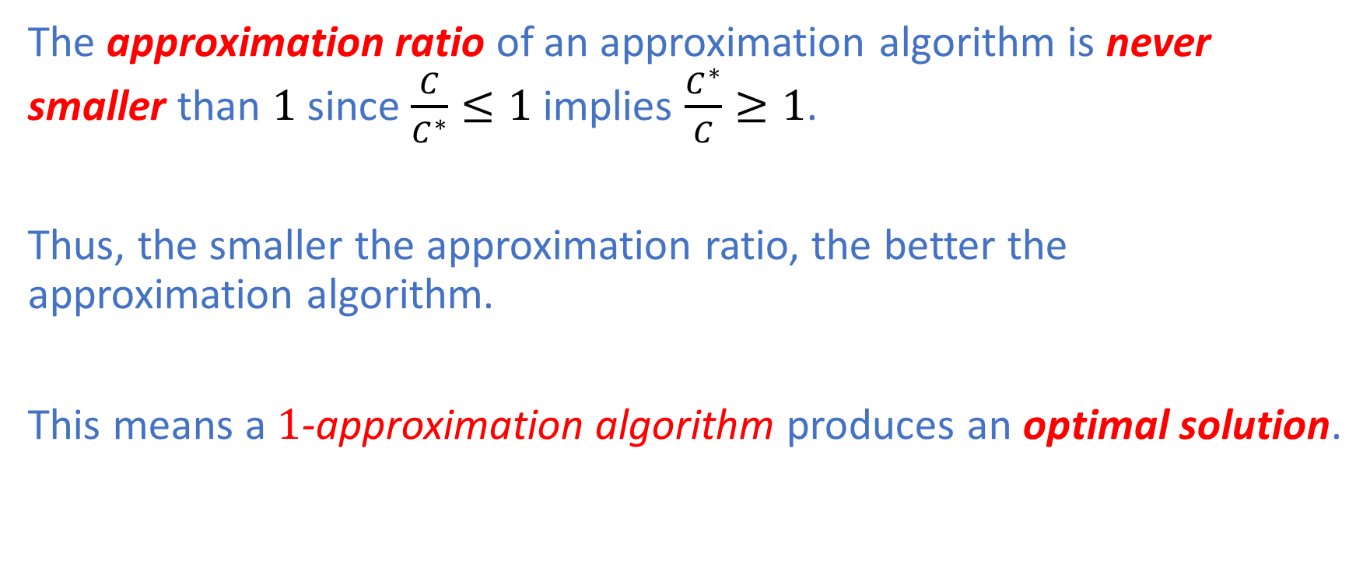
Approximation Ratios
The approximation ratio of an approximation algorithm is never smaller than $1$ since $\frac{C}{C^{∗}}≤1$ implies $\frac{C^{∗}}{C}≥1$.
Thus, the smaller the approximation ratio, the better the approximation algorithm.
This means a $1$-approximation algorithm produces an optimal solution.

Slide 8
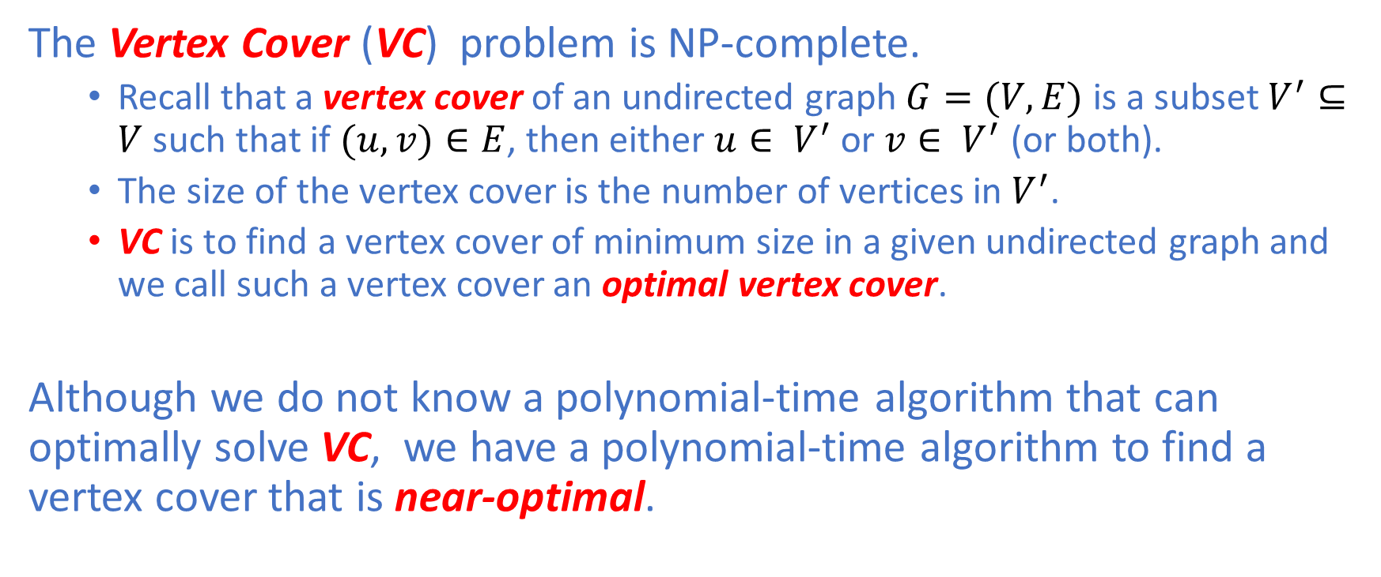
Vertex Cover
The Vertex Cover (VC) problem is NP-complete.
Recall that a vertex cover of an undirected graph $G=(V,E)$ is a subset $V^{′}⊆V$ such that if $(u,v)∈E$, then either $u∈ V^{′}$ or $v∈ V^{′}$ (or both).
The size of the vertex cover is the number of vertices in $V^{′}$.
VC is to find a vertex cover of minimum size in a given undirected graph and we call such a vertex cover an optimal vertex cover.
Although we do not know a polynomial-time algorithm that can optimally solve VC, we have a polynomial-time algorithm to find a vertex cover that is near-optimal.

Slide 9
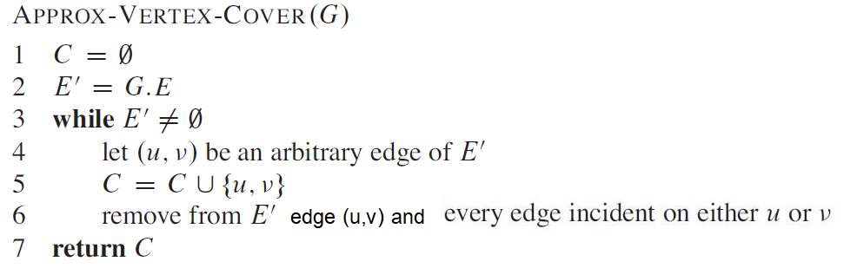

Vertex Cover
The approximate algorithm takes $G=(V,E)$ as input and returns a vertex cover $V^{′}$ whose size is guaranteed to be no larger than twice the size of an optimal vertex cover ${V^{′}}_{opt}$, hence a $2$-approximation algorithm.

Slide 10
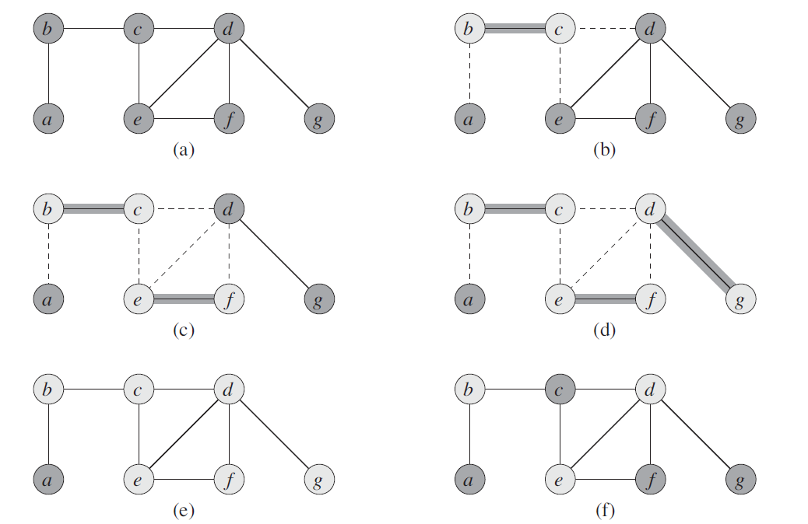
Vertex Cover: Example

Slide 11
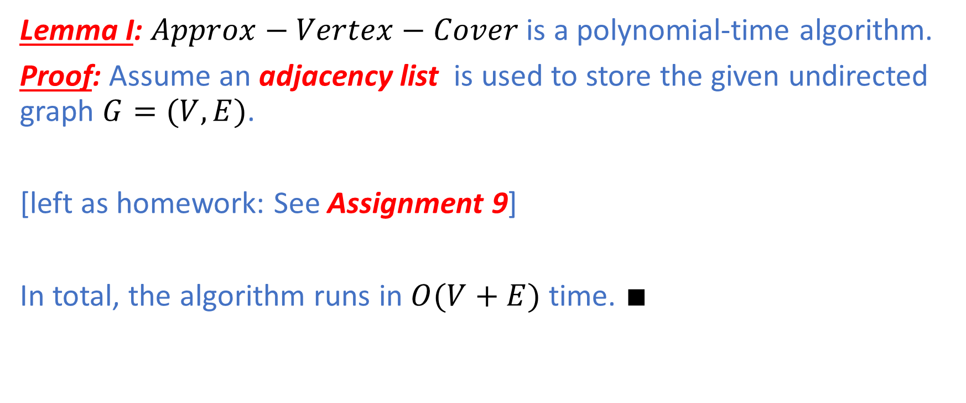
Vertex Cover
Lemma I: $Approx−Vertex−Cover$ is a polynomial-time algorithm.
Proof: Assume an adjacency list is used to store the given undirected graph $G=(V,E)$.
[left as homework: See Assignment 9]
In total, the algorithm runs in $O(V+E)$ time. $∎$

Slide 12
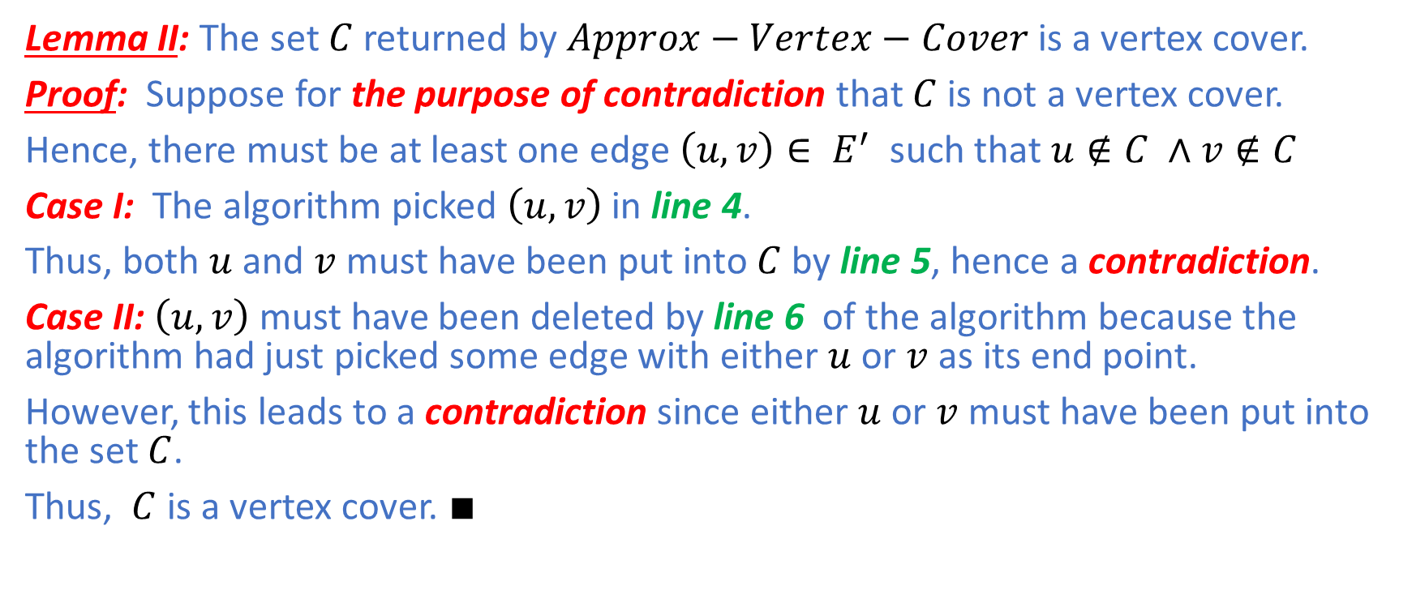
Vertex Cover
Lemma II: The set $C$returned by $Approx−Vertex−Cover$ is a vertex cover.
Proof: Suppose for the purpose of contradiction that $C$ is not a vertex cover.
Hence, there must be at least one edge $\left(u,v\right)∈ E^{′}$ such that $u∉C ∧v∉C$
Case I: The algorithm picked $\left(u,v\right)$in line 4.
Thus, both $u$ and $v$ must have been put into $C$ by line 5, hence a contradiction.
Case II: $\left(u,v\right)$ must have been deleted by line 6 of the algorithm because the algorithm had just picked some edge with either $u$ or $v$ as its end point.
However, this leads to a contradiction since either $u$ or $v$ must have been put into the set $C$.
Thus, $C$ is a vertex cover. $∎$

Slide 13
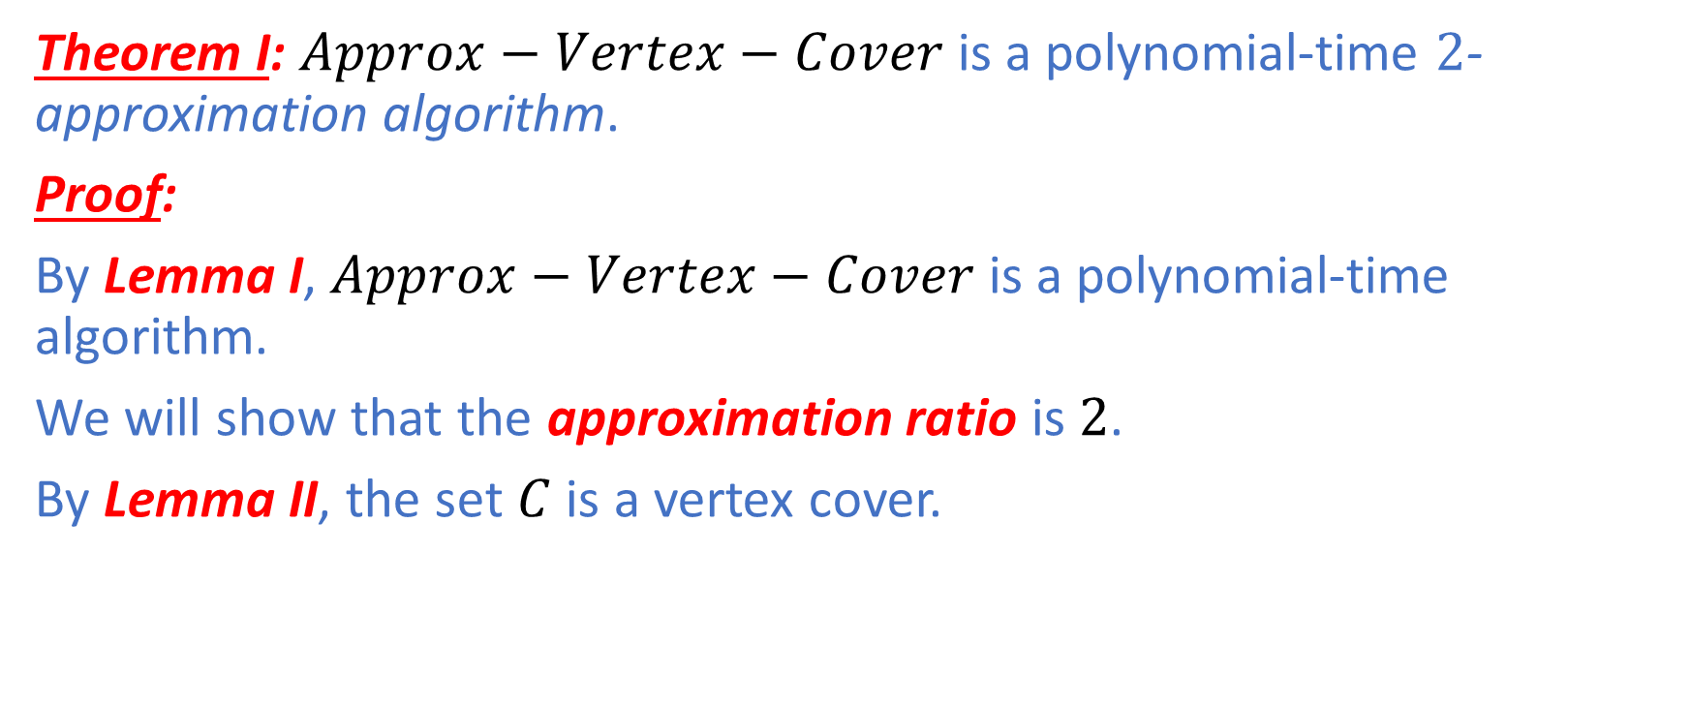
Vertex Cover
Theorem I: $Approx−Vertex−Cover$ is a polynomial-time $2$-approximation algorithm.
Proof:
By Lemma I, $Approx−Vertex−Cover$ is a polynomial-time algorithm.
We will show that the approximation ratio is $2$.
By Lemma II, the set $C$ is a vertex cover.

Slide 14
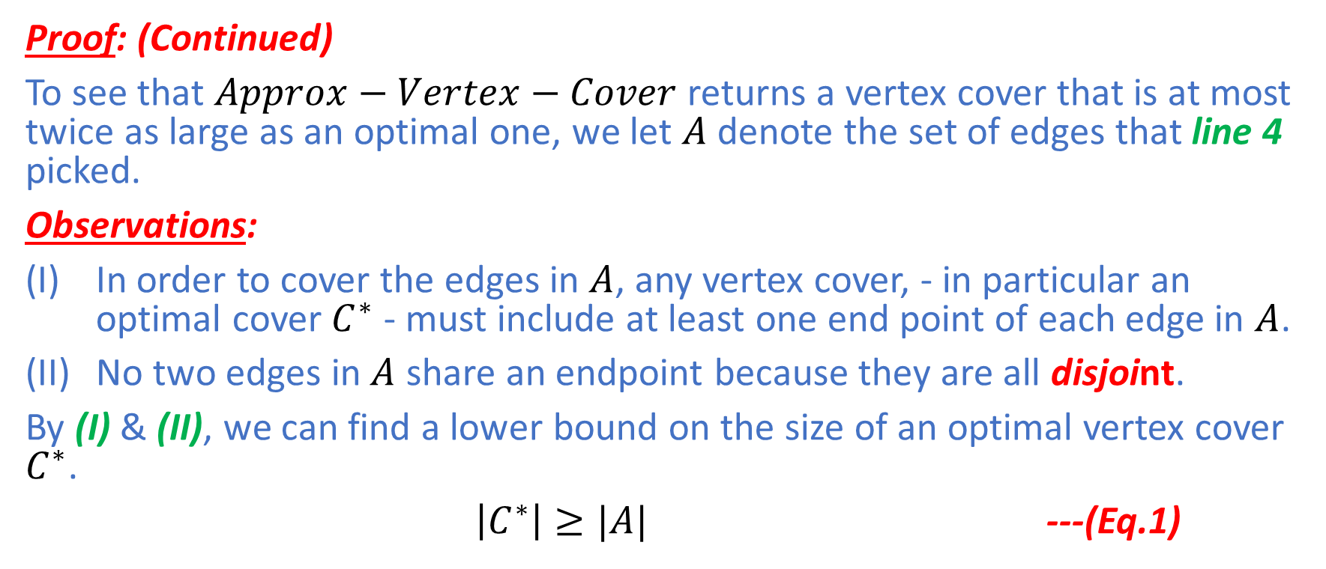
Vertex Cover
Proof: (Continued)
To see that $Approx−Vertex−Cover$ returns a vertex cover that is at most twice as large as an optimal one, we let $A$ denote the set of edges that line 4 picked.
Observations:
In order to cover the edges in $A$, any vertex cover, - in particular an optimal cover $C^{∗}$ - must include at least one end point of each edge in $A$.
No two edges in$A$ share an endpoint because they are all disjoint.
By (I) & (II), we can find a lower bound on the size of an optimal vertex cover $C^{∗}$.
$\left|C^{∗}\right|≥|A|$ ---(Eq.1)

Slide 15
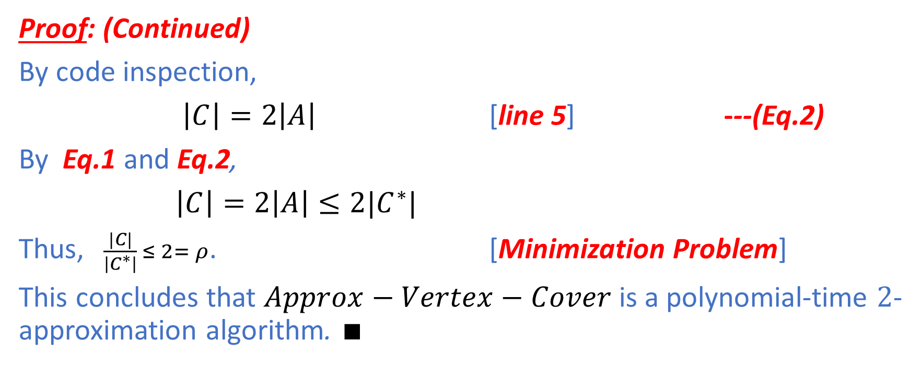
Vertex Cover
Proof: (Continued)
By code inspection,
$\left|C\right|=2\left|A\right|$ [line 5] ---(Eq.2)
By Eq.1 and Eq.2,
$\left|C\right|=2\left|A\right|≤2|C^{∗}|$
Thus, $\frac{|C|}{\left|C^{∗}\right|} ≤ 2= ρ$. [Minimization Problem]
This concludes that $Approx−Vertex−Cover$ is a polynomial-time $2$-approximation algorithm. $∎$

Slide 16
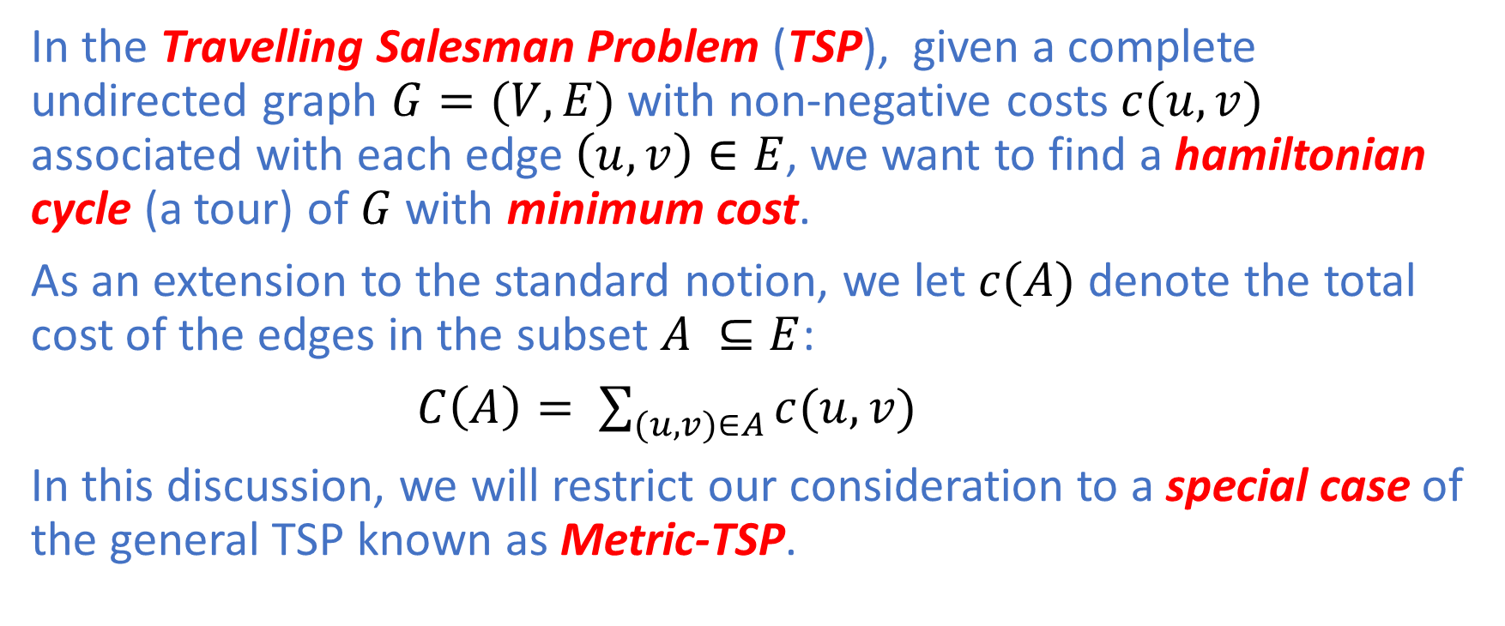
Travelling Salesman
In the Travelling Salesman Problem (TSP), given a complete undirected graph $G=(V,E)$ with non-negative costs $c(u,v)$ associated with each edge $\left(u,v\right)∈E$, we want to find a hamiltonian cycle (a tour) of $G$ with minimum cost.
As an extension to the standard notion, we let $c(A)$ denote the total cost of the edges in the subset $A ⊆E$:
$C\left(A\right)= \sum_{(u,v)∈A}{c(u,v)}$
In this discussion, we will restrict our consideration to a special case of the general TSP known as Metric-TSP.

Slide 17
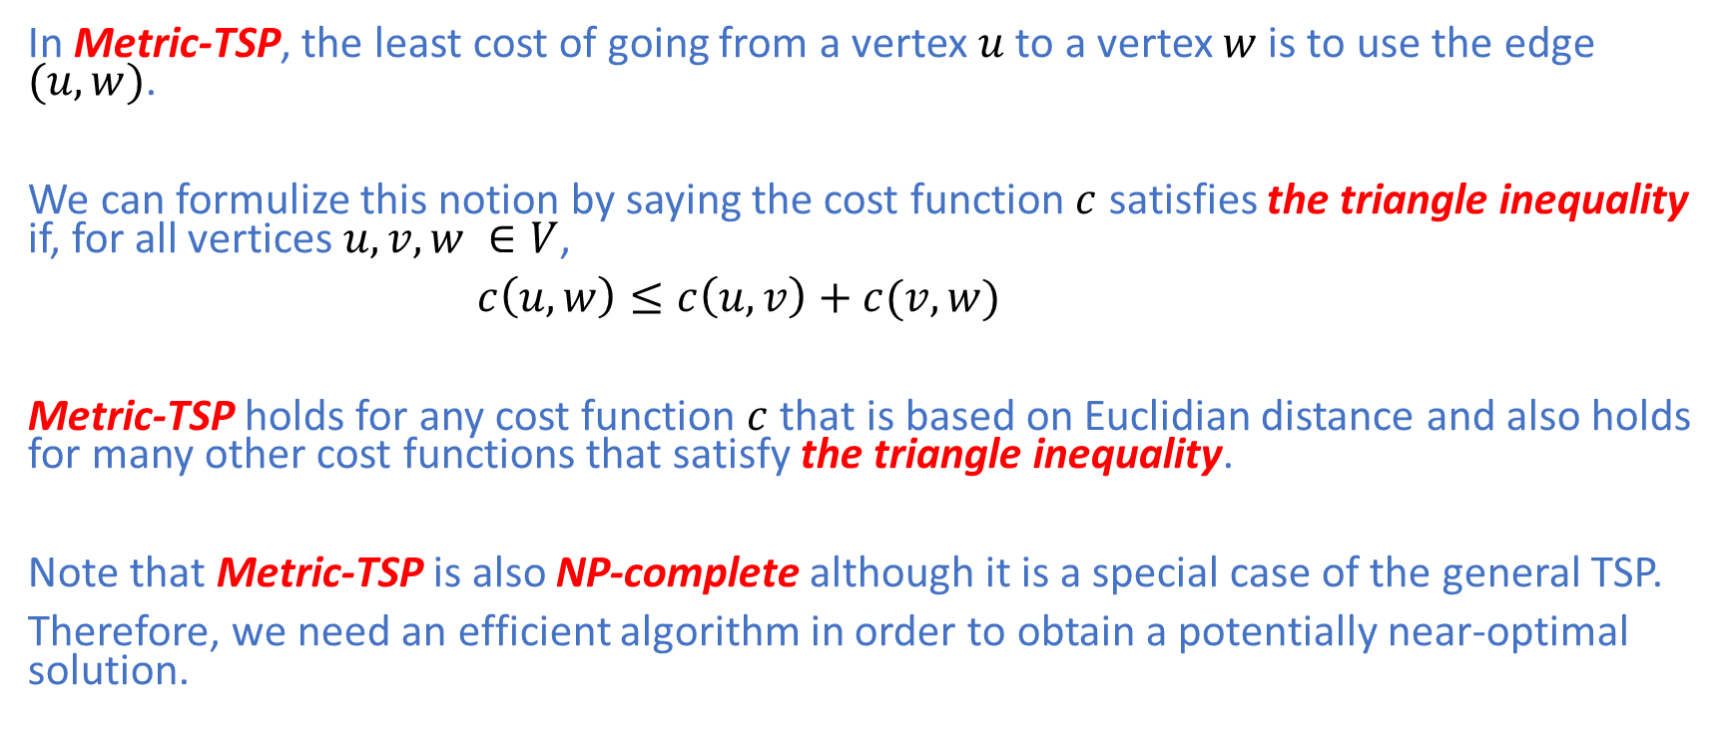
Metric-TSP
In Metric-TSP, the least cost of going from a vertex $u$ to a vertex $w$ is to use the edge $(u,w)$.
We can formulize this notion by saying the cost function $c$ satisfies the triangle inequality if, for all vertices $u,v,w ∈V$,
$c\left(u,w\right)≤c\left(u,v\right)+c(v,w)$
Metric-TSP holds for any cost function $c$ that is based on Euclidian distance and also holds for many other cost functions that satisfy the triangle inequality.
Note that Metric-TSP is also NP-complete although it is a special case of the general TSP.
Therefore, we need an efficient algorithm in order to obtain a potentially near-optimal solution.

Slide 18
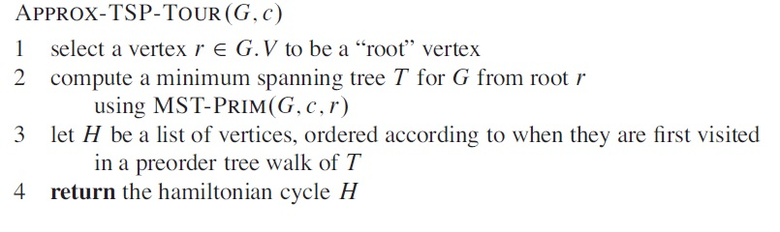

Metric-TSP
Knowing that Metric-TSP is NP-complete, we develop a 2-approximation algorithm $Approx−TSP−Tour$ with the help of Prim’s algorithm.

Slide 19
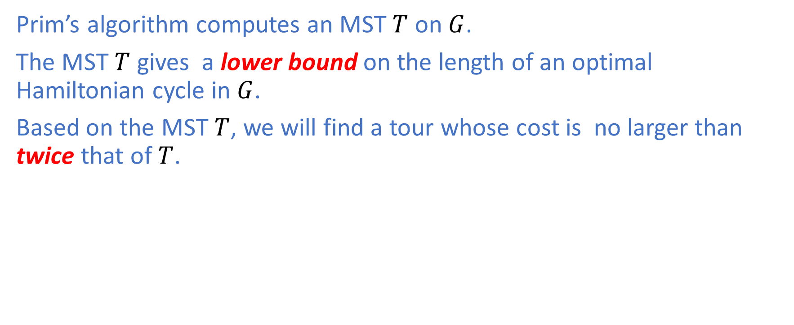
Metric-TSP
Prim’s algorithm computes an MST $T$ on $G$.
The MST $T$ gives a lower bound on the length of an optimal Hamiltonian cycle in $G$.
Based on the MST $T$, we will find a tour whose cost is no larger than twice that of $T$.

Slide 20
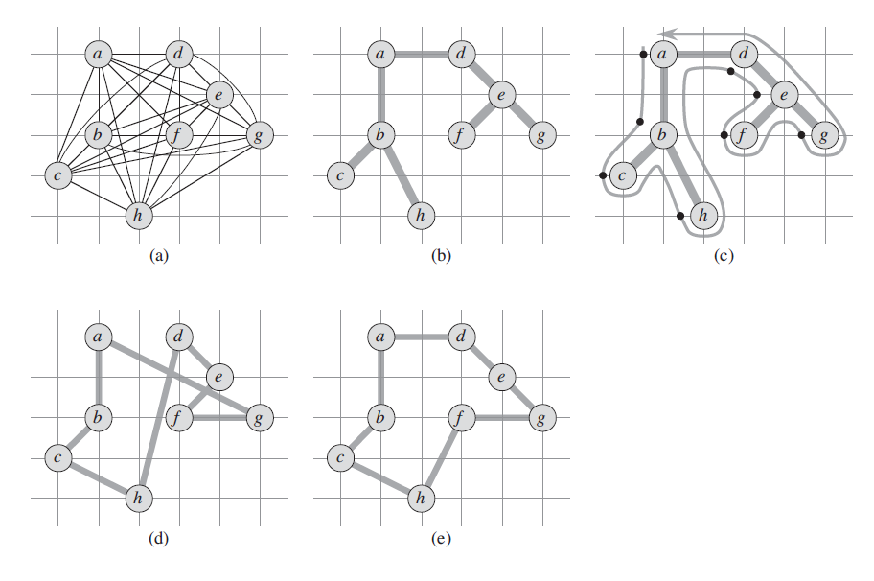
Metric-TSP: Example

Slide 21
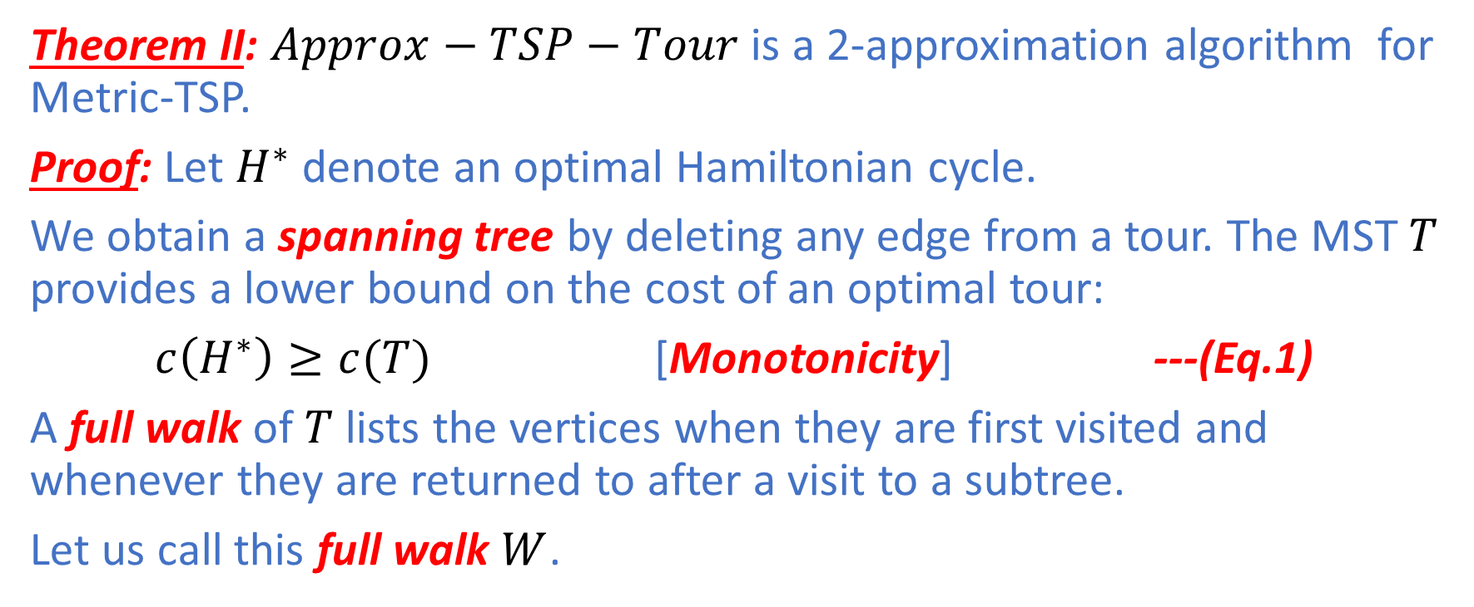
Metric-TSP
Theorem II: $Approx−TSP−Tour$ is a 2-approximation algorithm for Metric-TSP.
Proof: Let $H^{∗}$ denote an optimal Hamiltonian cycle.
We obtain a spanning tree by deleting any edge from a tour. The MST $T$ provides a lower bound on the cost of an optimal tour:
$c\left(H^{∗}\right)≥c(T)$ [Monotonicity] ---(Eq.1)
A full walk of $T$ lists the vertices when they are first visited and whenever they are returned to after a visit to a subtree.
Let us call this full walk $W$.

Slide 22
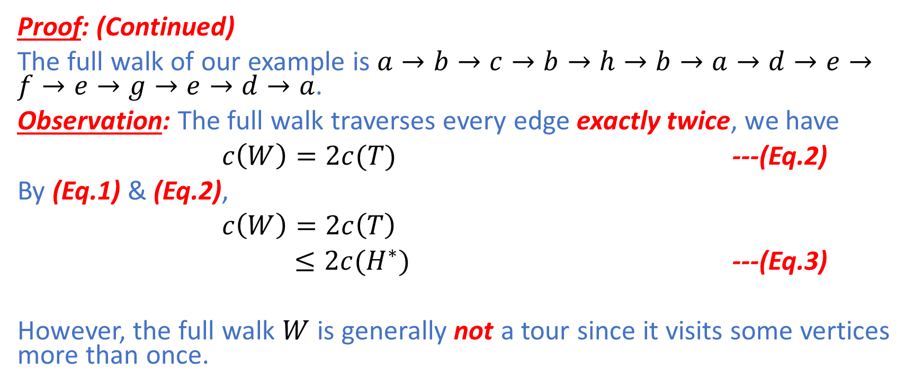
Metric-TSP
Proof: (Continued)
The full walk of our example is $a→b→c→b→h→b→a→d→e→f→e→g→e→d→a$.
Observation: The full walk traverses every edge exactly twice, we have
$c\left(W\right)=2c(T)$ ---(Eq.2)
By (Eq.1) & (Eq.2),
$c\left(W\right)=2c\left(T\right)$
$≤2c(H^{∗})$ ---(Eq.3)
However, the full walk $W$ is generally not a tour since it visits some vertices more than once.

Slide 23
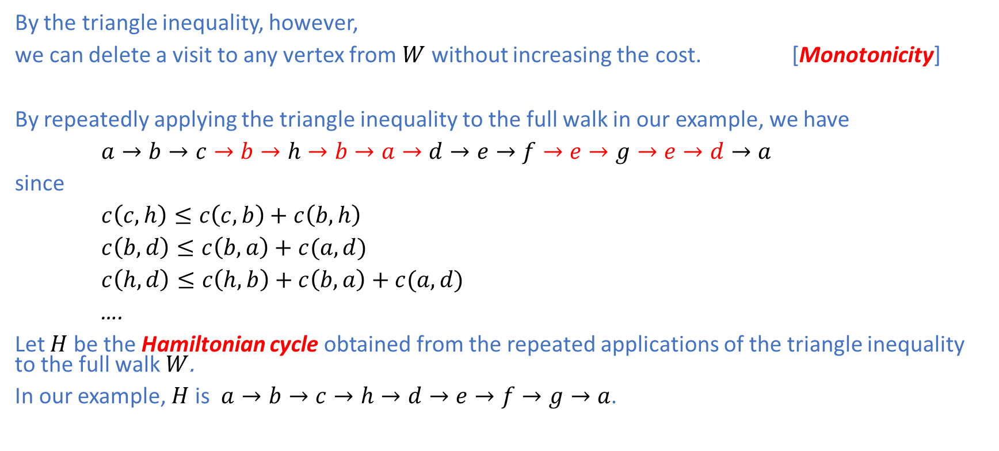
Metric-TSP
By the triangle inequality, however,
we can delete a visit to any vertex from $W$ without increasing the cost. [Monotonicity]
By repeatedly applying the triangle inequality to the full walk in our example, we have
$a→b→c→b→h→b→a→d→e→f→e→g→e→d→a$
since
$c\left(c,h\right)≤c\left(c,b\right)+c\left(b,h\right)$
$c\left(b,d\right)≤c\left(b,a\right)+c(a,d)$
$c\left(h,d\right)≤c\left(h,b\right)+c\left(b,a\right)+c(a,d)$
….
Let $H$ be the Hamiltonian cycle obtained from the repeated applications of the triangle inequality to the full walk $W$.
In our example, $H$is $a→b→c→h→d→e→f→g→a$.

Slide 24
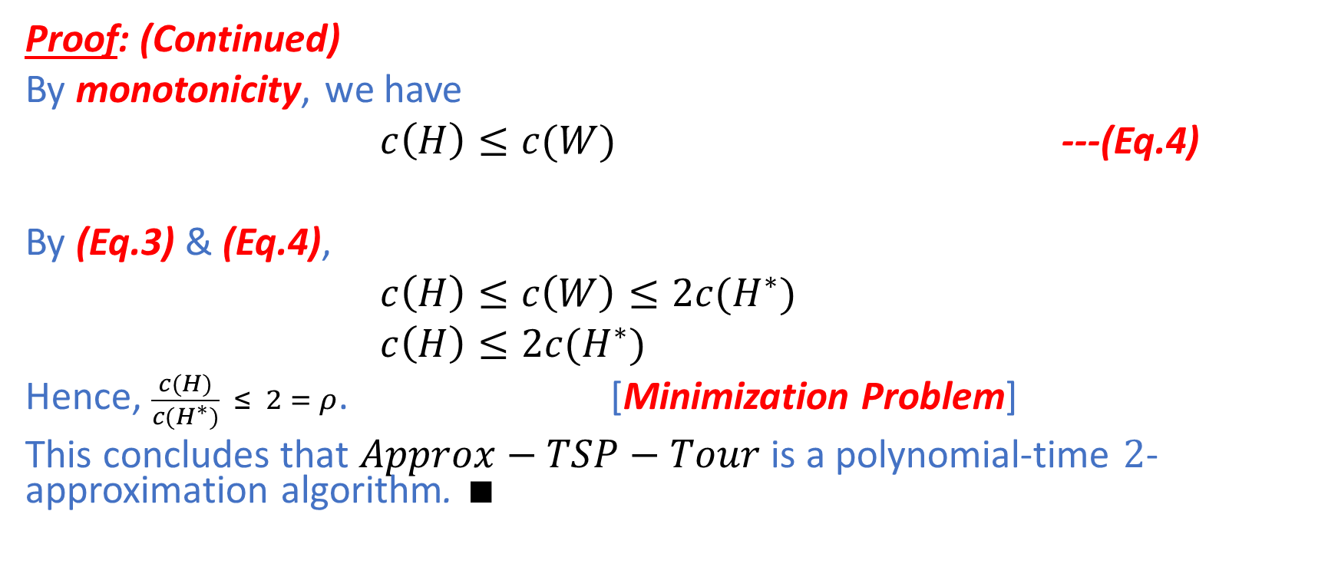
Metric-TSP
Proof: (Continued)
By monotonicity, we have
$c\left(H\right)≤c(W)$ ---(Eq.4)
By (Eq.3) & (Eq.4),
$c\left(H\right)≤c\left(W\right)≤2c(H^{∗})$
$c\left(H\right)≤2c(H^{∗})$
Hence, $\frac{c(H)}{c(H^{∗})} ≤ 2 = ρ$. [Minimization Problem]
This concludes that $Approx−TSP−Tour$ is a polynomial-time $2$-approximation algorithm. $∎$

Slide 25
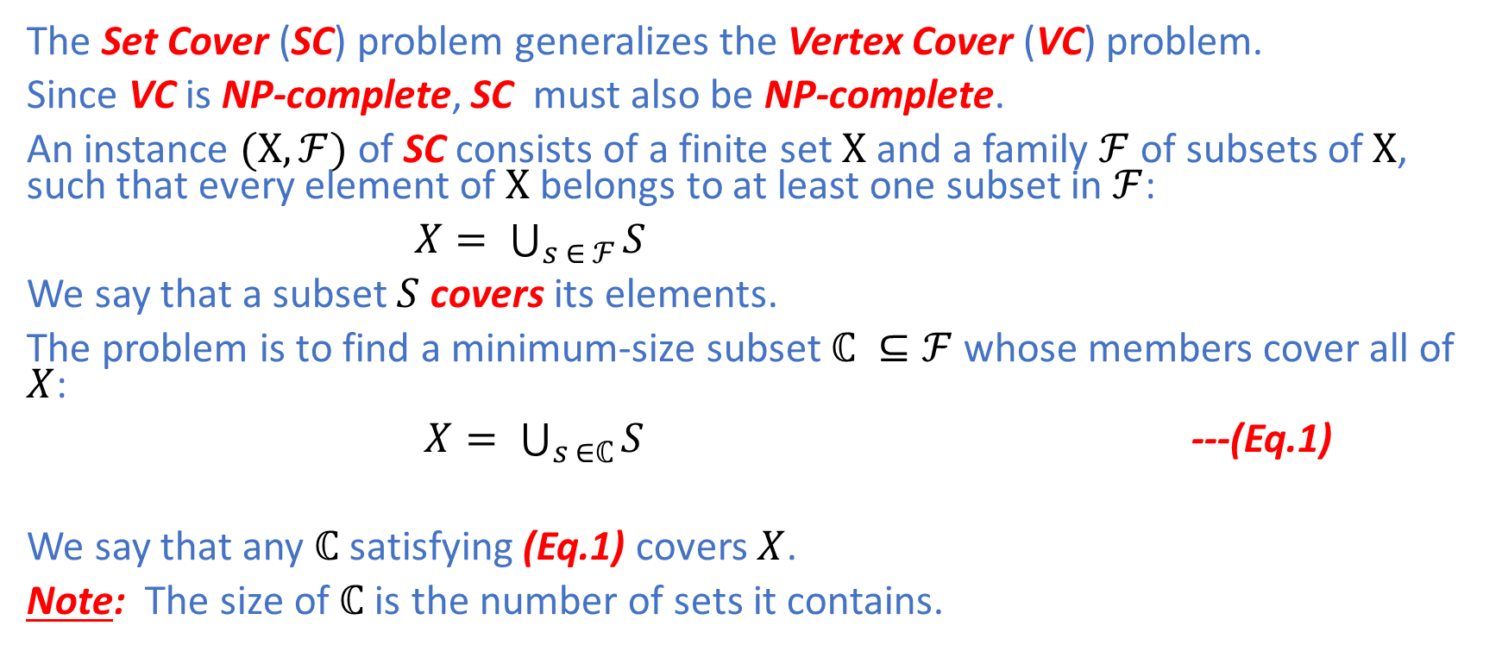
Set Cover
The Set Cover (SC) problem generalizes the Vertex Cover (VC) problem.
Since VC is NP-complete, SC must also be NP-complete.
An instance $(Χ,ℱ)$ of SC consists of a finite set $Χ$ and a family $ℱ$ of subsets of $Χ$, such that every element of $Χ$ belongs to at least one subset in $ℱ$:
$X= \bigcup_{s ∈ ℱ}{S}$
We say that a subset $S$ covers its elements.
The problem is to find a minimum-size subset $ℂ ⊆ℱ$ whose members cover all of $X$:
$X= \bigcup_{s ∈ℂ}{S}$ ---(Eq.1)
We say that any $ℂ$ satisfying (Eq.1) covers $X$.
Note: The size of$ℂ$ is the number of sets it contains.

Slide 26
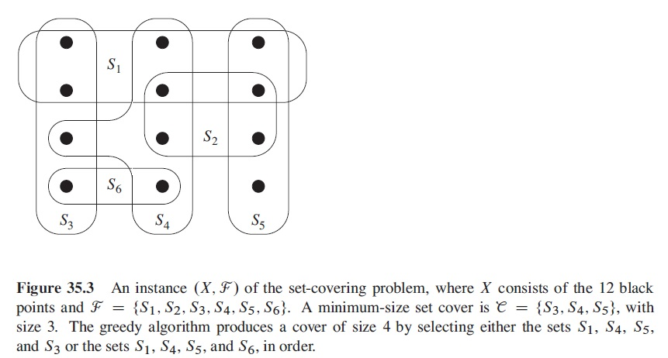
Set Cover: Example

Slide 27
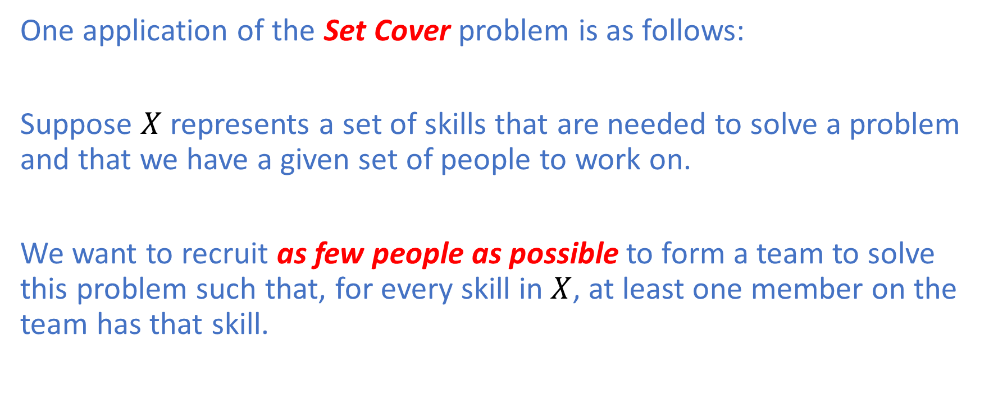
Set Cover: Application
One application of the Set Cover problem is as follows:
Suppose $X$ represents a set of skills that are needed to solve a problem and that we have a given set of people to work on.
We want to recruit as few people as possible to form a team to solve this problem such that, for every skill in $X$, at least one member on the team has that skill.

Slide 28
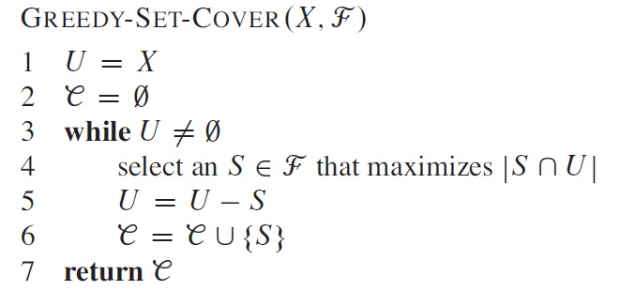

Set Cover
A greedy approximation algorithm $Approx−Set−Cover$ for SC works as follows:
Greedy Choice: $Approx−Set−Cover$iteratively picks a set $S$ that covers the largest number of remaining elements that remain uncovered, breaking ties arbitrarily.

Slide 29
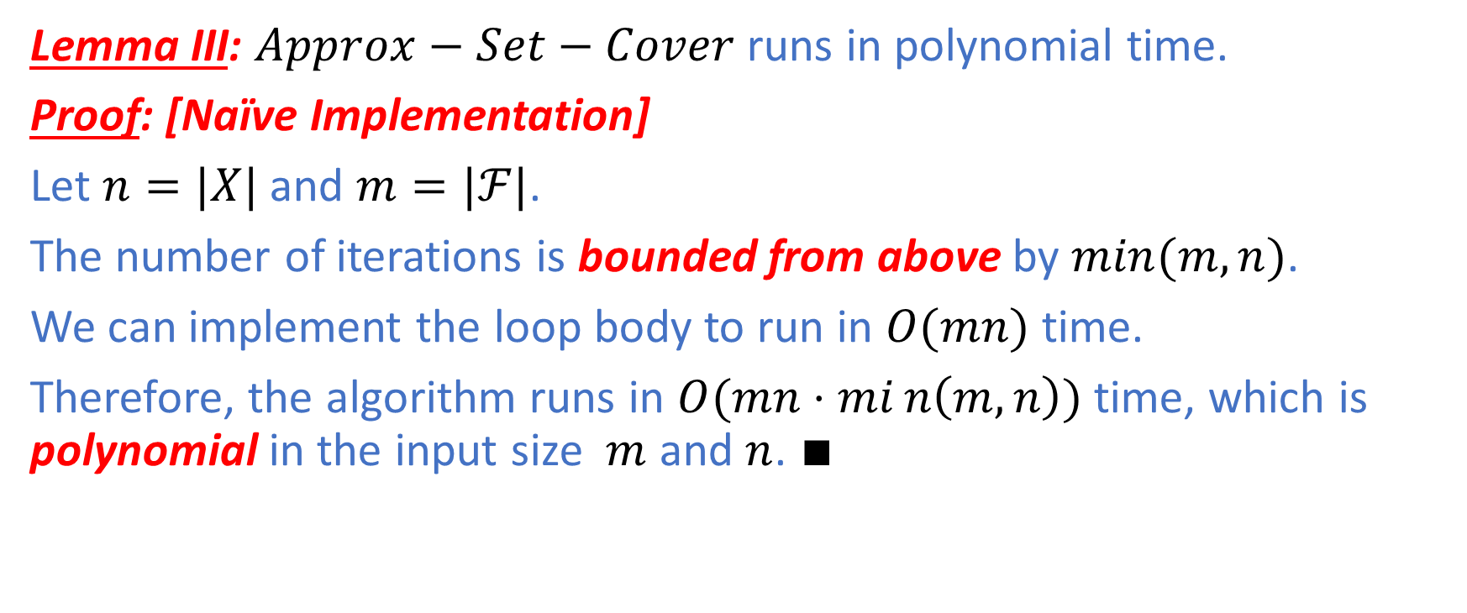
Set Cover: Running Time
Lemma III: $Approx−Set−Cover$ runs in polynomial time.
Proof: [Naïve Implementation]
Let $n=|X|$ and $m=|ℱ|$.
The number of iterations is bounded from above by $min(m,n)$.
We can implement the loop body to run in $O(mn)$ time.
Therefore, the algorithm runs in $O(mn⋅min\left(m,n\right))$ time, which is polynomial in the input size $m$ and $n$. $∎$

Slide 30
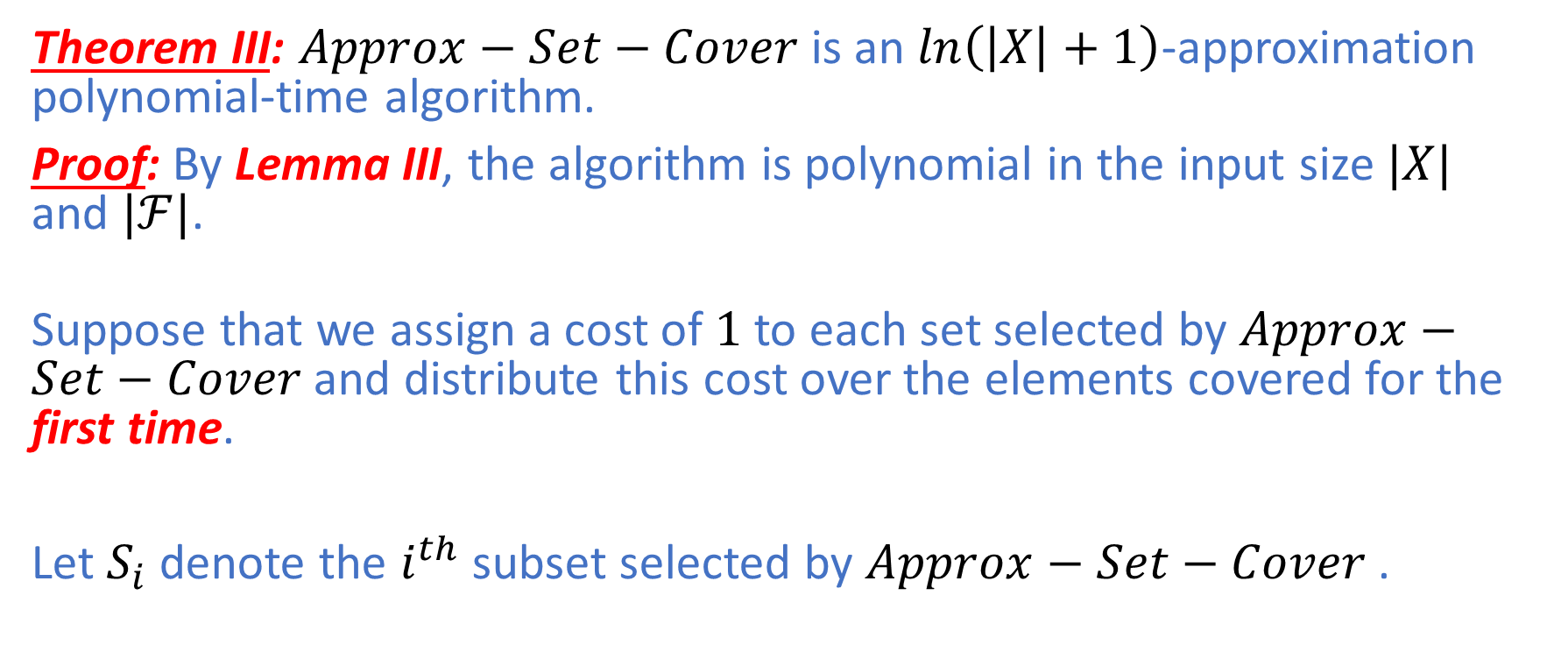
Set Cover
Theorem III: $Approx−Set−Cover$ is an $\ln\left(\left|X\right|+1\right)$-approximation polynomial-time algorithm.
Proof: By Lemma III, the algorithm is polynomial in the input size$|X|$ and $|ℱ|$.
Suppose that we assign a cost of $1$ to each set selected by $Approx−Set−Cover$ and distribute this cost over the elements covered for the first time.
Let $S_{i}$ denote the $i^{th}$ subset selected by $Approx−Set−Cover$ .

Slide 31
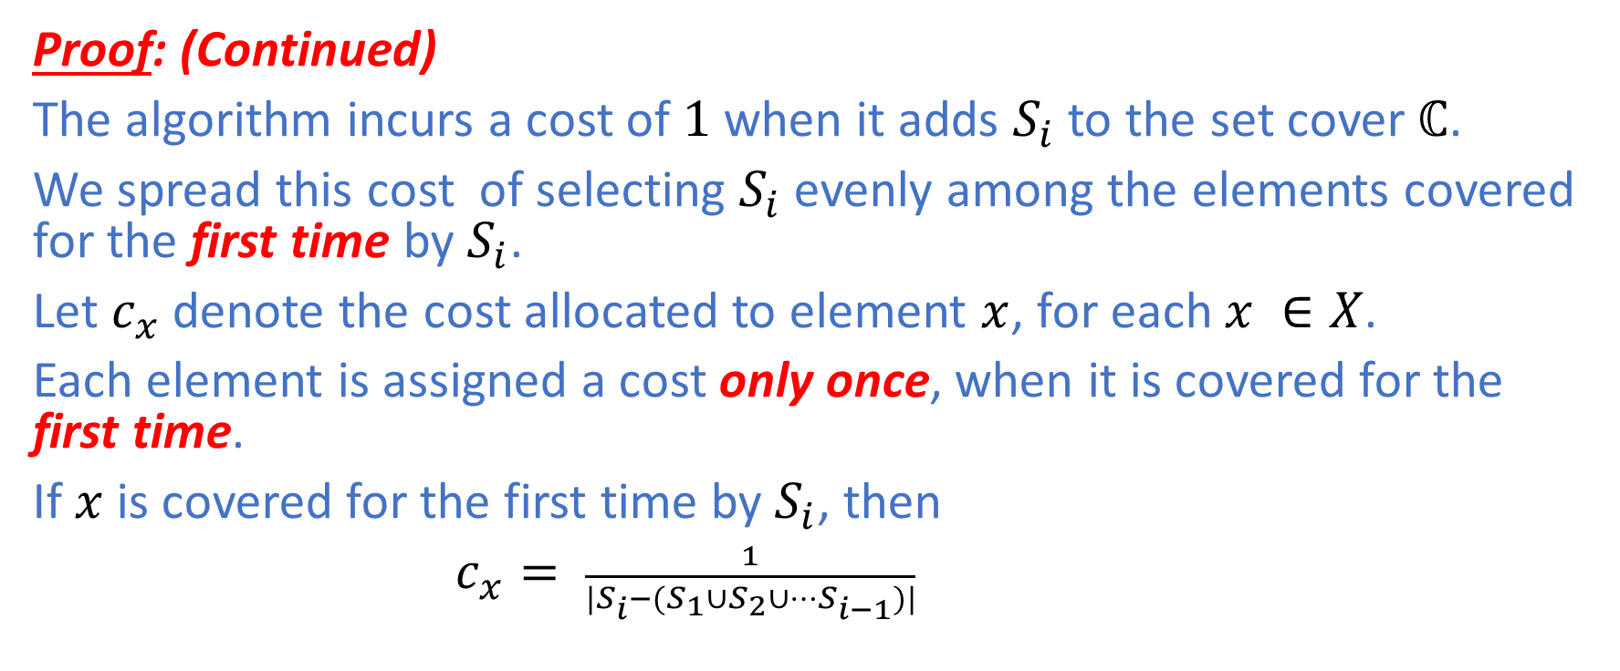
Set Cover
Proof: (Continued)
The algorithm incurs a cost of $1$ when it adds $S_{i}$ to the set cover $ℂ$.
We spread this cost of selecting $S_{i}$ evenly among the elements covered for the first time by $S_{i}$.
Let $c_{x}$ denote the cost allocated to element $x$, for each $x ∈X$.
Each element is assigned a cost only once, when it is covered for the first time.
If $x$ is covered for the first time by $S_{i}$, then
$c_{x}= \frac{1}{|S_{i}−(S_{1}∪S_{2}∪…S_{i−1})|}$

Slide 32
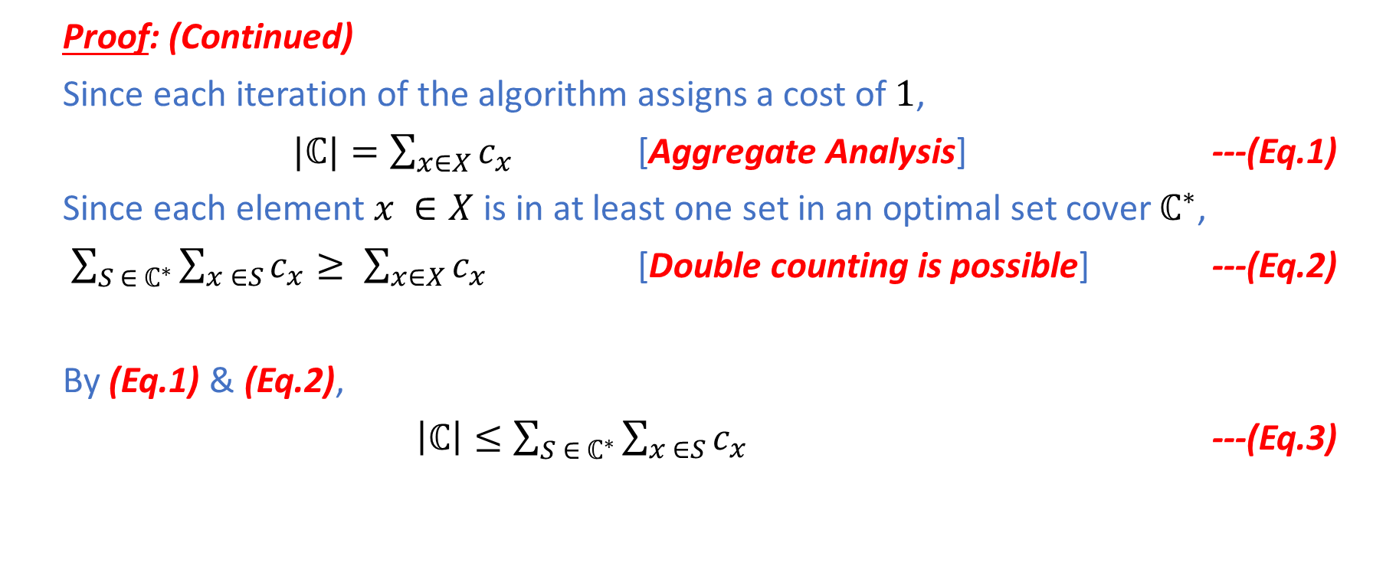
Set Cover
Proof: (Continued)
Since each iteration of the algorithm assigns a cost of $1$,
$|ℂ|=\sum_{x∈X}{c_{x}}$ [Aggregate Analysis] ---(Eq.1)
Since each element $x ∈X$ is in at least one set in an optimal set cover $ℂ^{∗}$,
$\sum_{S ∈ ℂ^{∗}}{\sum_{x ∈S}{c_{x}}}≥ \sum_{x∈X}{c_{x}}$ [Double counting is possible] ---(Eq.2)
By (Eq.1) & (Eq.2),
$\left|ℂ\right|≤\sum_{S ∈ ℂ^{∗}}{\sum_{x ∈S}{c_{x}}}$ ---(Eq.3)

Slide 33
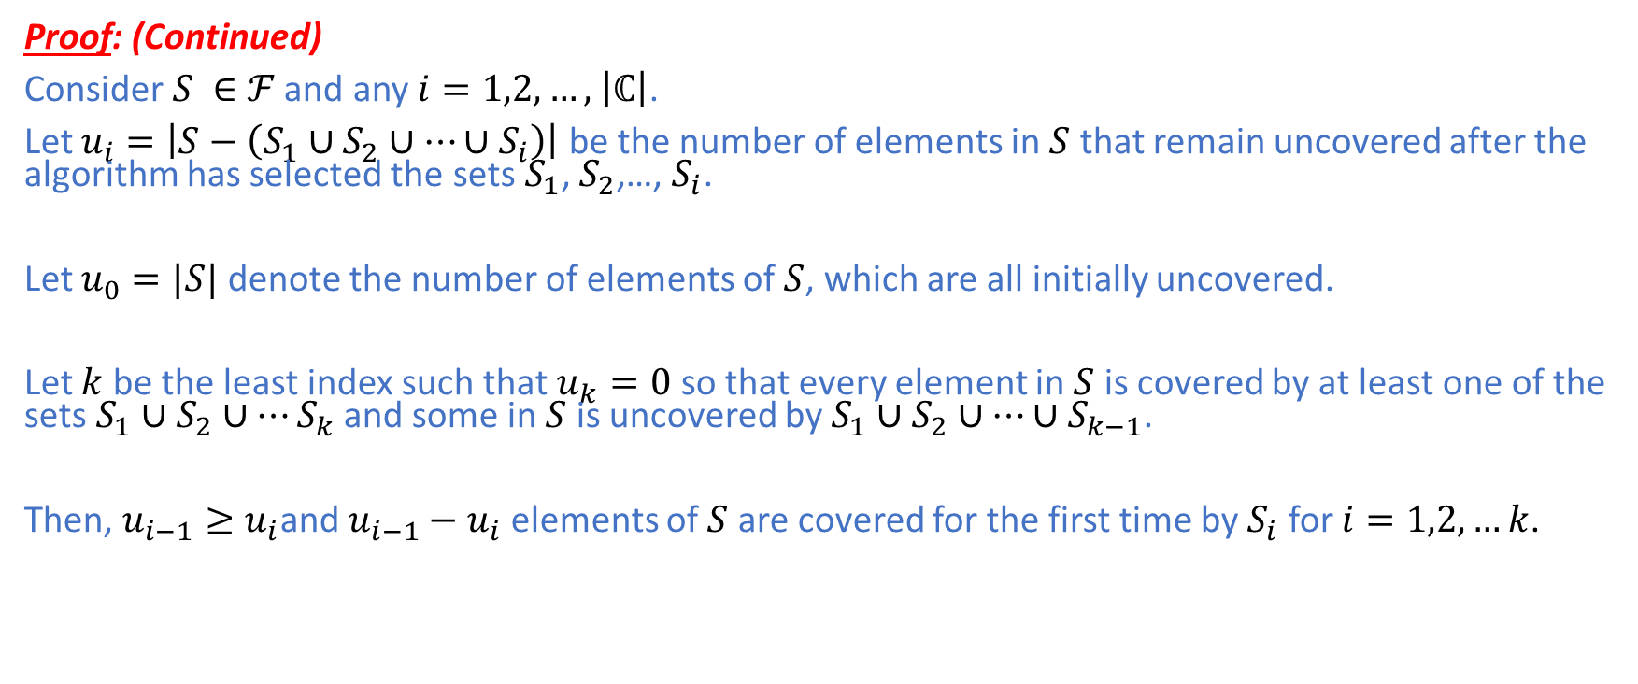
Set Cover
Proof: (Continued)
Consider $S ∈$ $ℱ$ and any $i=1,2,…,$ $\left|ℂ\right|$.
Let $u_{i}=\left|S−\left(S_{1}∪S_{2}∪…{∪S}_{i}\right)\right|$ be the number of elements in $S$ that remain uncovered after the algorithm has selected the sets $S_{1}$, $S_{2}$,…, $S_{i}$.
Let $u_{0}=|S|$ denote the number of elements of $S$, which are all initially uncovered.
Let $k$ be the least index such that $u_{k}=0$ so that every element in $S$ is covered by at least one of the sets $S_{1}∪S_{2}∪…S_{k}$ and some in $S$ is uncovered by $S_{1}∪S_{2}∪…{∪S}_{k−1}$.
Then, $u_{i−1}≥u_{i}$and $u_{i−1}−u_{i}$ elements of $S$ are covered for the first time by $S_{i}$ for $i=1,2,…k$.

Slide 34
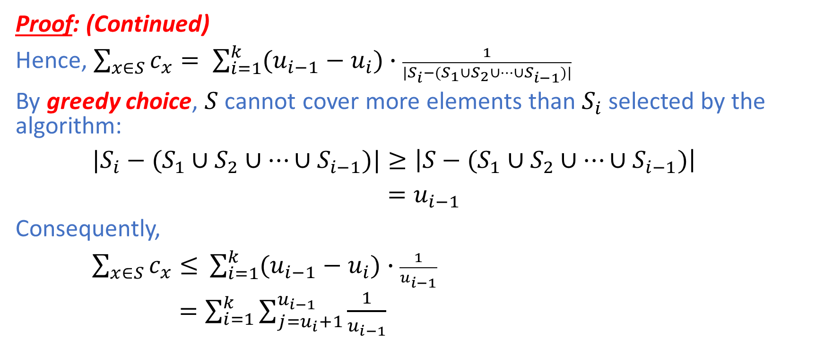
Set Cover
Proof: (Continued)
Hence, $\sum_{x∈S}{c_{x}}= \sum_{i=1}^{k}{(u_{i−1}−u_{i})∙\frac{1}{{|S_{i}−(S}_{1}∪S_{2}∪…{∪S}_{i−1})|}}$
By greedy choice, $S$ cannot cover more elements than $S_{i}$ selected by the algorithm:
${|S_{i}−(S}_{1}∪S_{2}∪…{∪S}_{i−1})|≥\left|{S−(S}_{1}∪S_{2}∪…{∪S}_{i−1})\right|$
$=u_{i−1}$
Consequently,
$\sum_{x∈S}{c_{x}≤ }$ $\sum_{i=1}^{k}{(u_{i−1}−u_{i})∙\frac{1}{u_{i−1}}}$
$=\sum_{i=1}^{k}{\sum_{j=u_{i}+1}^{u_{i−1}}{\frac{1}{u_{i−1}}}}$

Slide 35
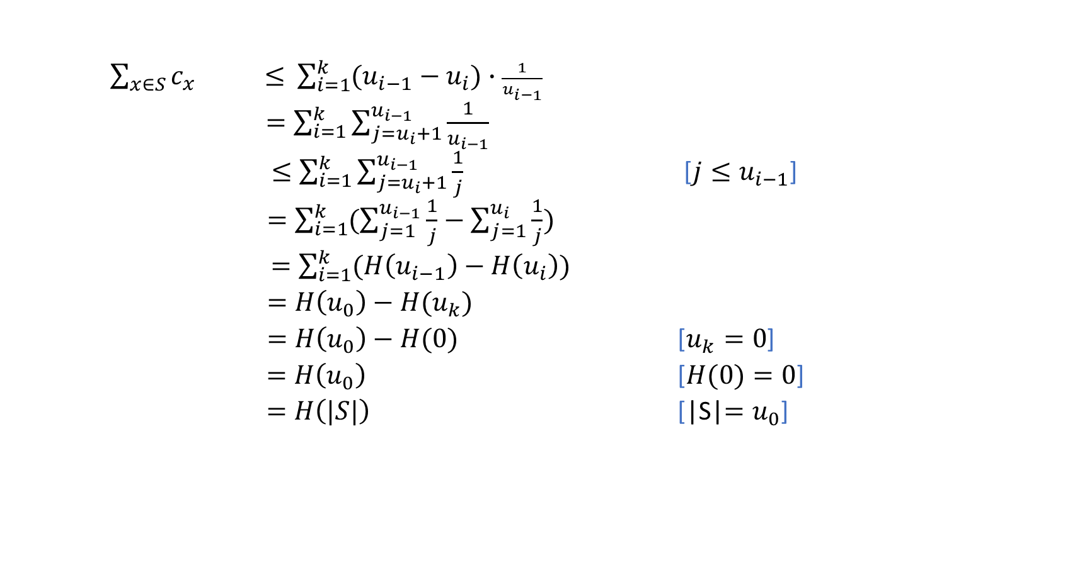
Set Cover
$\sum_{x∈S}{c_{x} ≤ }$ $\sum_{i=1}^{k}{(u_{i−1}−u_{i})∙\frac{1}{u_{i−1}}}$
$=\sum_{i=1}^{k}{\sum_{j=u_{i}+1}^{u_{i−1}}{\frac{1}{u_{i−1}}}}$
$≤\sum_{i=1}^{k}{\sum_{j=u_{i}+1}^{u_{i−1}}{\frac{1}{j}}}$ [$j≤u_{i−1}$]
$=\sum_{i=1}^{k}{(\sum_{j=1}^{u_{i−1}}{\frac{1}{j}−\sum_{j=1}^{u_{i}}{\frac{1}{j}})}}$
$=\sum_{i=1}^{k}{(H\left(u_{i−1}\right)−H\left(u_{i}\right))}$
$=H\left(u_{0}\right)−H(u_{k})$
$=H\left(u_{0}\right)−H(0)$ [$u_{k}=0$]
$=H\left(u_{0}\right)$ [$H(0)=0$]
$=H\left(|S|\right)$ [|S|$=u_{0}$]

Slide 36
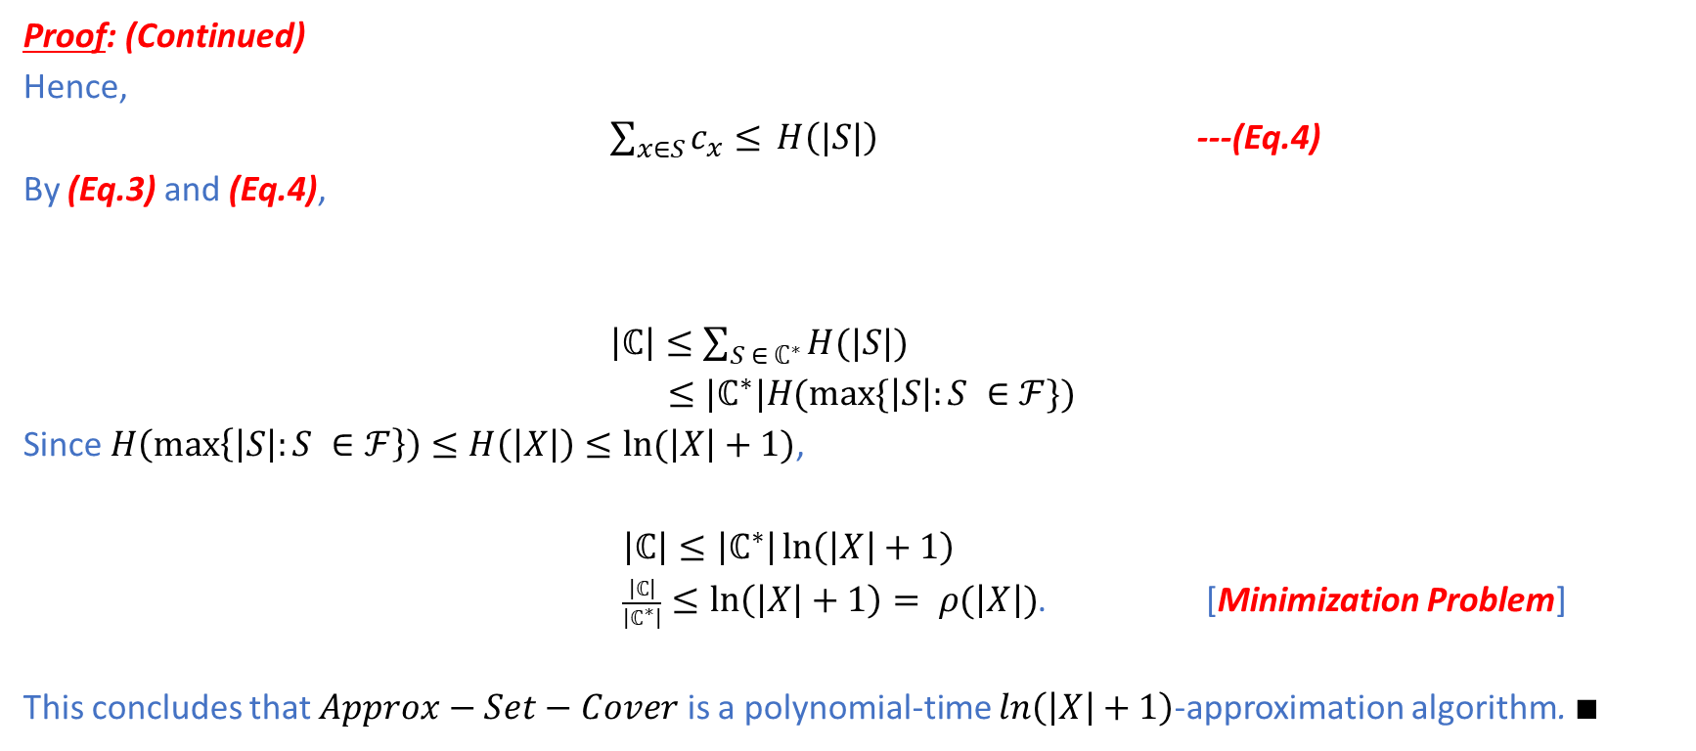
Set Cover
Proof: (Continued)
Hence,
$\sum_{x∈S}{c_{x}≤ }H\left(|S|\right)$ ---(Eq.4)
By (Eq.3) and (Eq.4),
$\left|ℂ\right|≤\sum_{S ∈ ℂ^{∗}}{H(|S|)}$
$≤|ℂ^{∗}|H(max⁡\{\left|S\right|:S ∈ℱ\})$
Since $H\left(\max\left\{\left|S\right|:S ∈ℱ\right\}\right)≤H\left(\left|X\right|\right)≤ln⁡(\left|X\right|+1)$,
$\left|ℂ\right|≤\left|ℂ^{∗}\right|\ln\left(\left|X\right|+1\right)$
$\frac{\left|ℂ\right|}{\left|ℂ^{∗}\right|}≤\ln\left(\left|X\right|+1\right)= ρ(\left|X\right|)$. [Minimization Problem]
This concludes that $Approx−Set−Cover$ is a polynomial-time $\ln\left(\left|X\right|+1\right)$-approximation algorithm. $∎$

Slide 37
Summary
Polynomial-time algorithms for optimization versions of NP-Complete problems may not exist.
Finding optimal solutions requires exponential time in terms of problem size.
One technique for solving this class of problems efficiently is to use approximation algorithms that guarantee the quality of their sub-optimal solutions relative to the optimal solutions.

